Slide 1


Slide 2
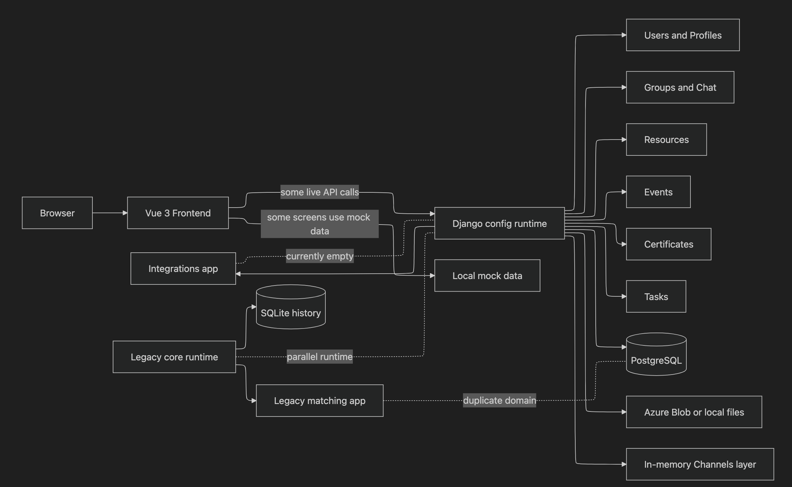
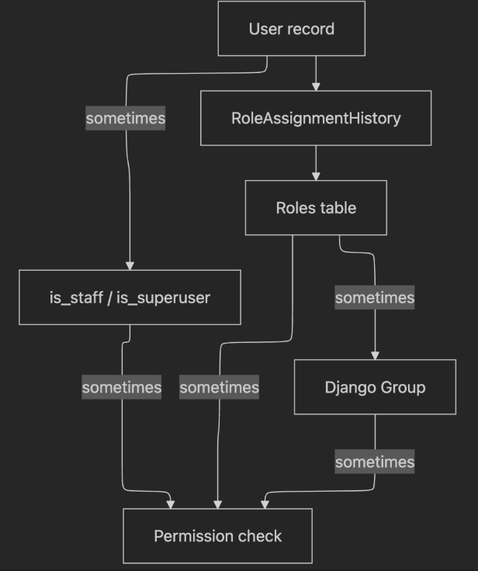

Slide 3
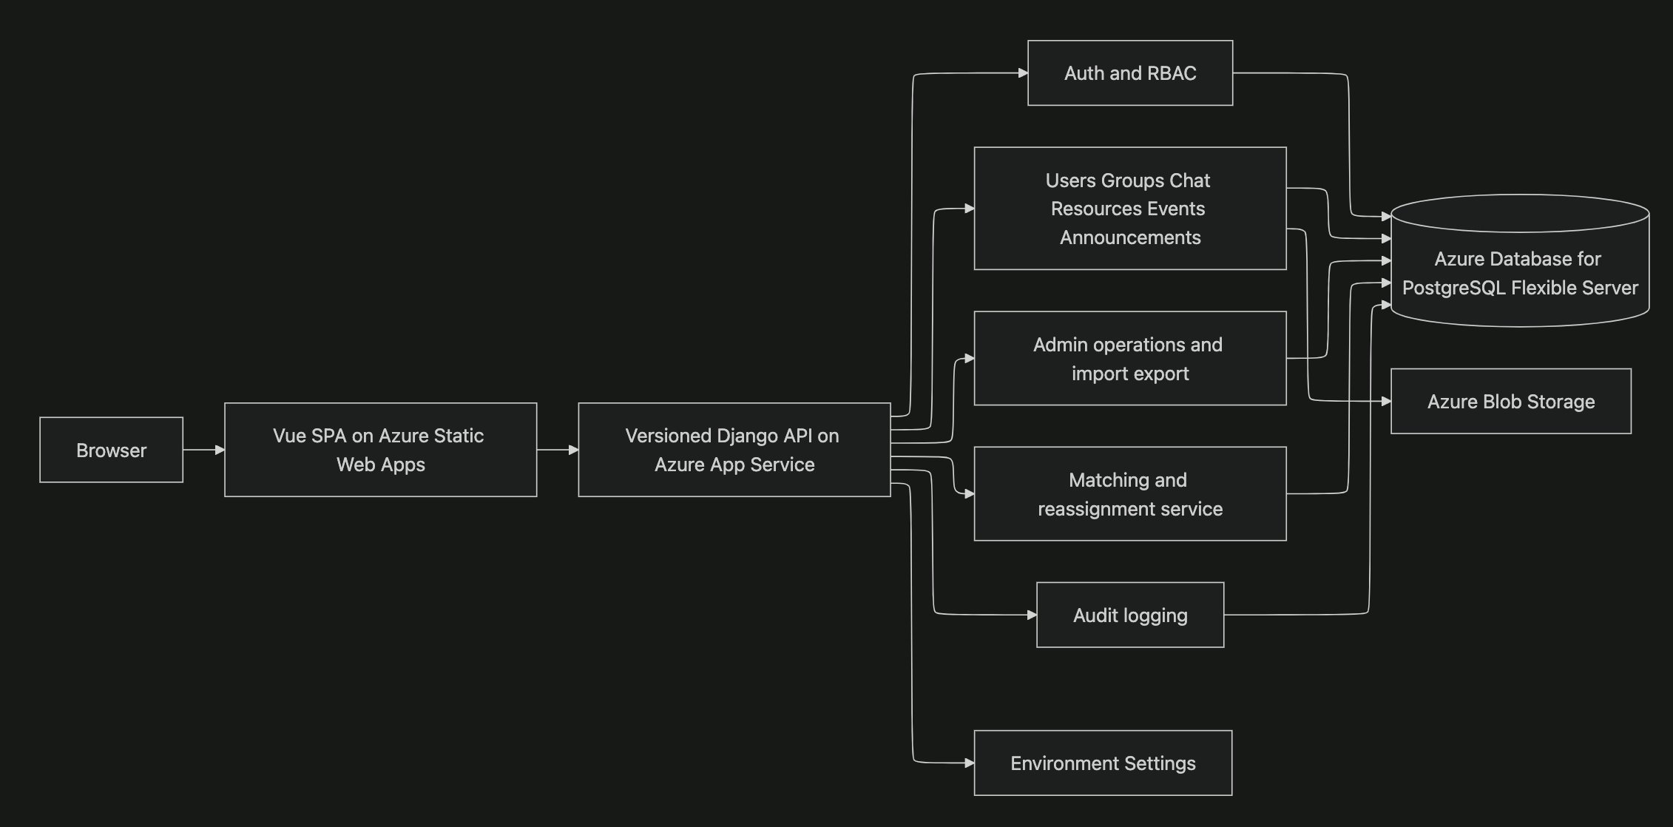
Notes:
Azure Static Web Apps
Azure App Service
Auzre PostgreSql Flexible Server
Azure Blob Storage

Slide 4
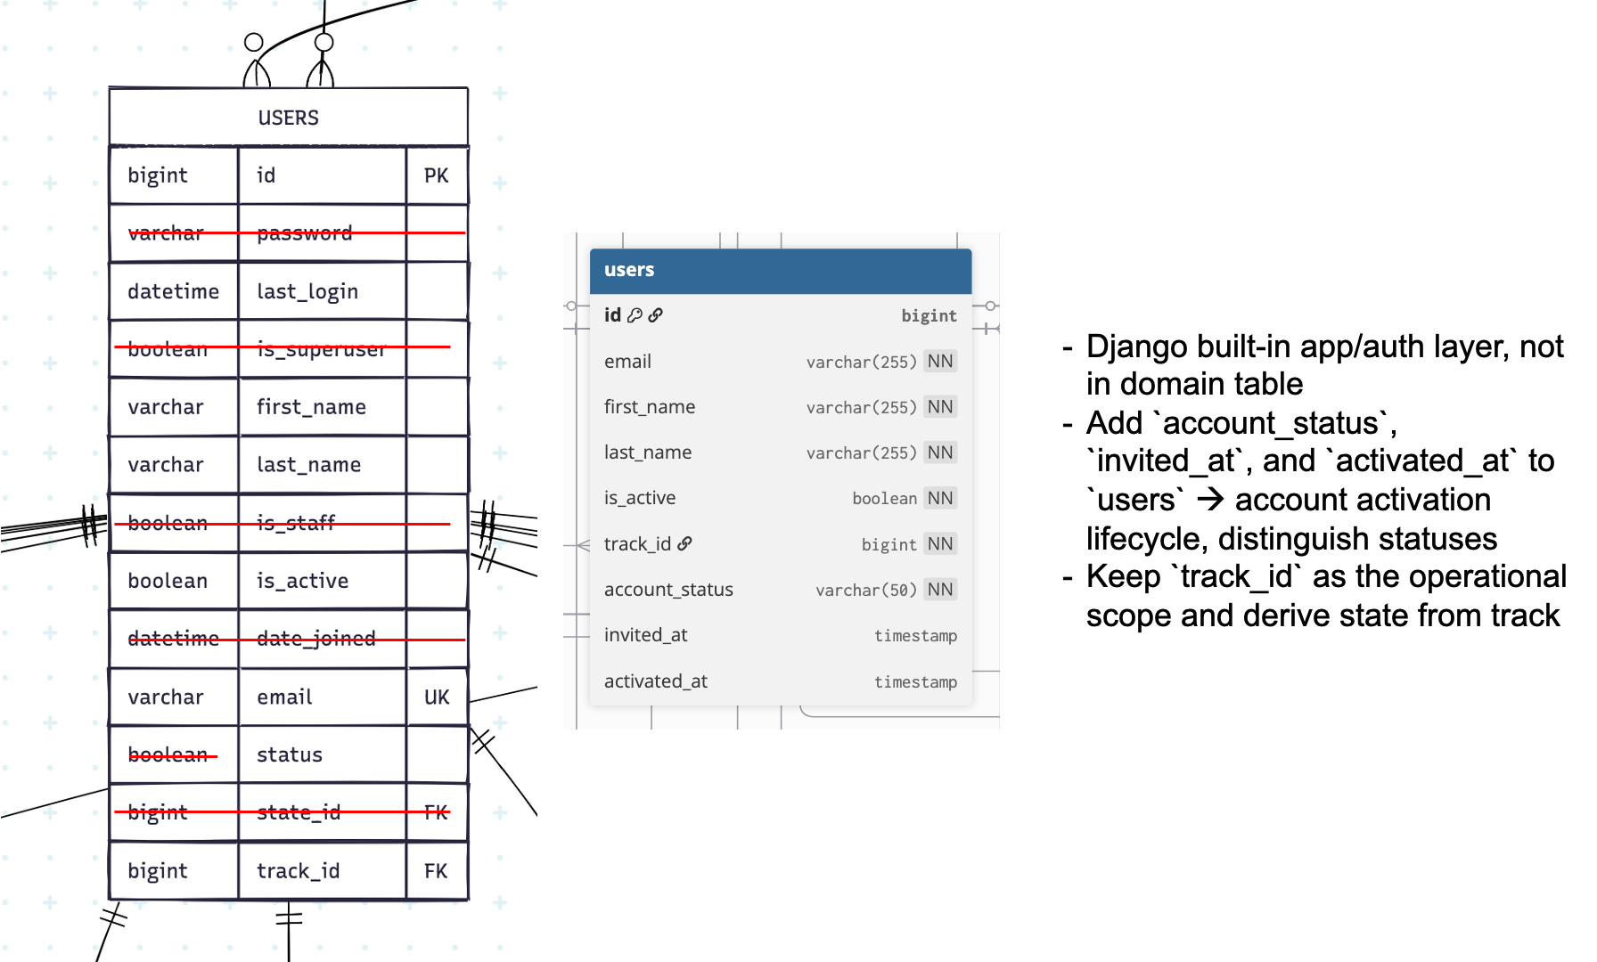

Slide 5
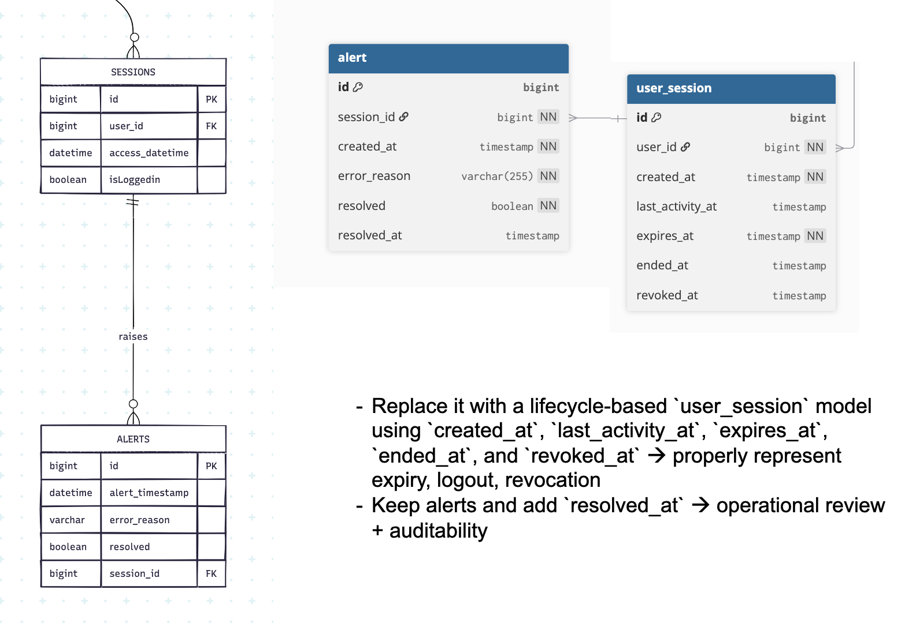

Slide 6
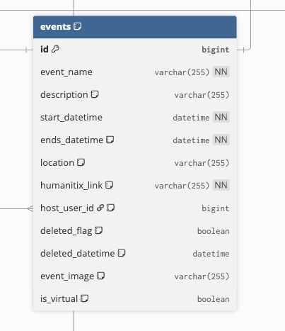
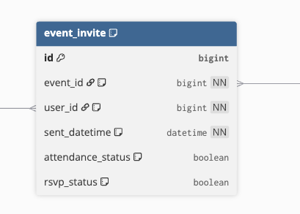
Delete vestigial link support for humanatix
Add support for google maps location link
Add capacity field
RSVP status to be updated to be able to handle multiple
RSVP time to be added

Slide 7
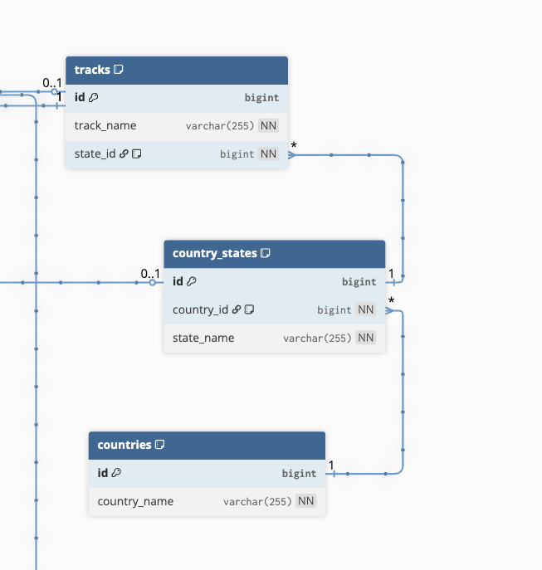
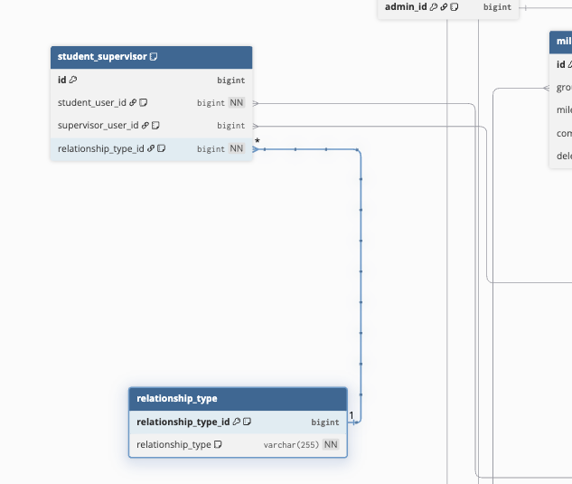
Right now tracks does not do anything we propose having country state and city tables mapping to countries and use that to assign RBAC
What is relationship type

Slide 8
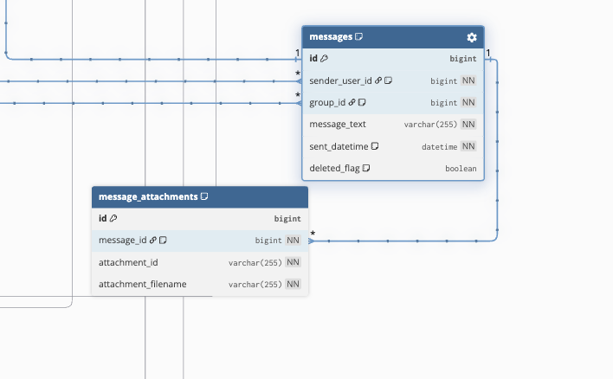
Messages currently limited to 255 charecters to be changed to text
No column to track message status – additional message tracking table required.
Message type to track presensce of attachment

Slide 9
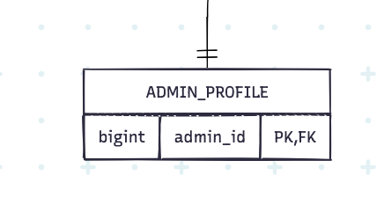
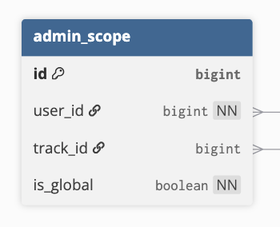
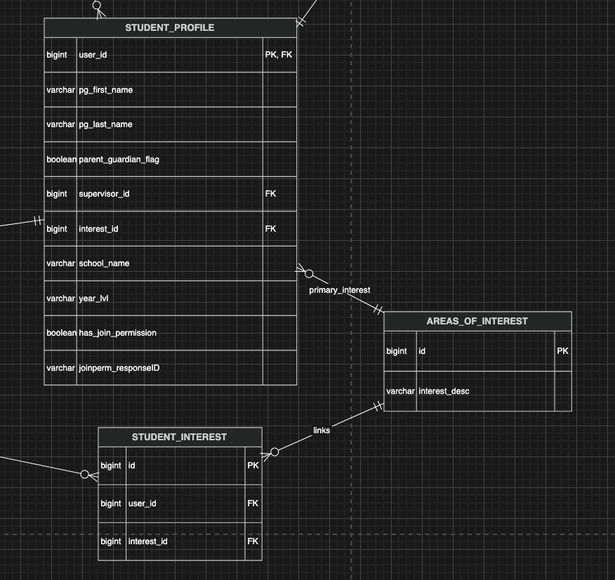
Current schema has `admin_profile`, but no local/global scope model -> introduce `admin_scope`, separate local vs global admin
Current schema stores interest in both `student_profile.interest_id` and `student_interest`

Slide 10
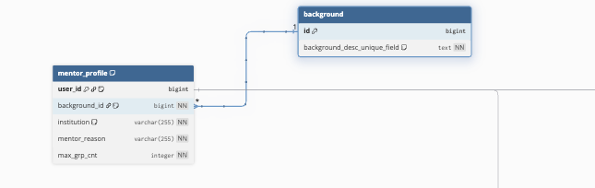
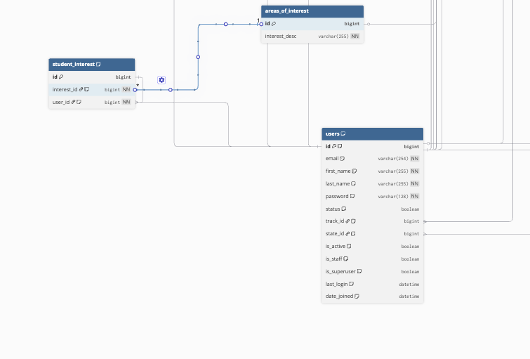
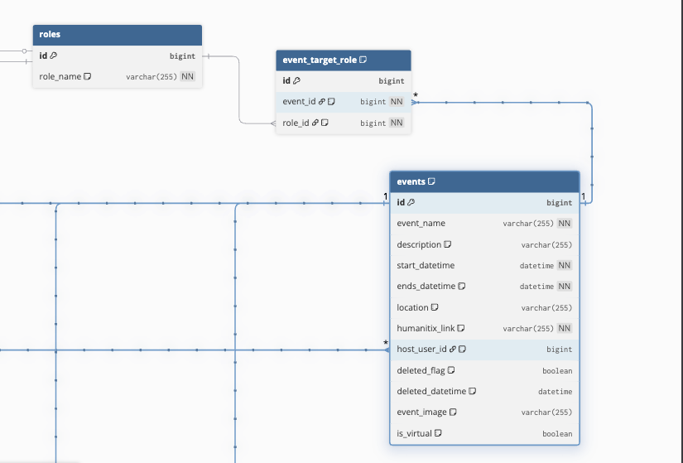
Tables to be deleted/Altered
Background table linked to mentor profile Student interest to be converted to user_interest to support mentors
Event role id to be deleted

Slide 11
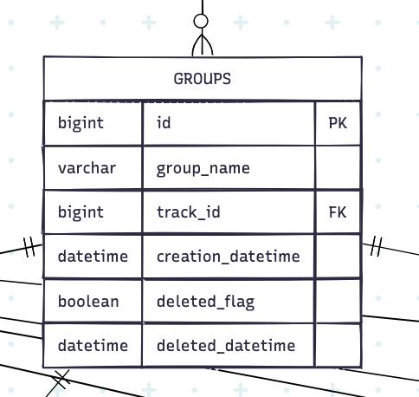
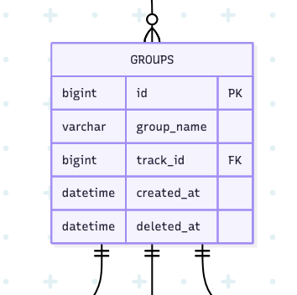
The current model uses a mix of boolean and timestamp flags
-> Normalise to simpler lifecycle management, simplify delete logic

Slide 12
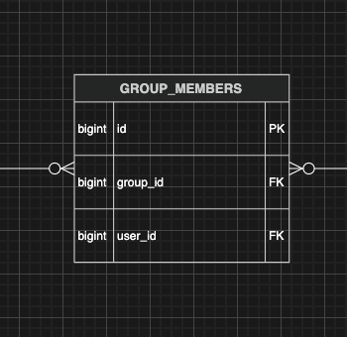
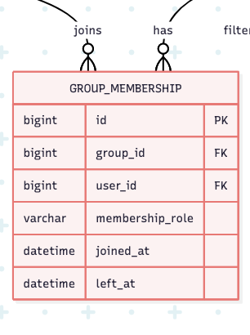
The current group_members simply a joint table, cannot track lifecycle or role within a group

Slide 13
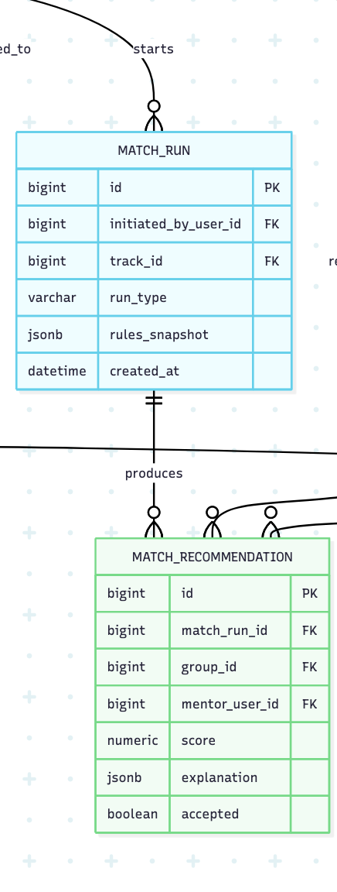
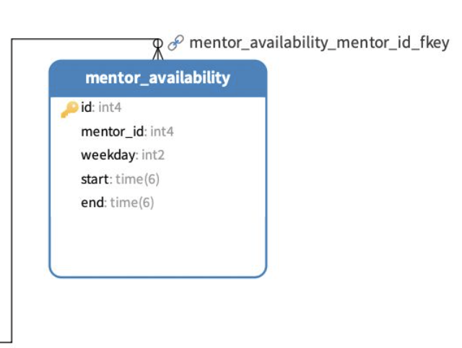
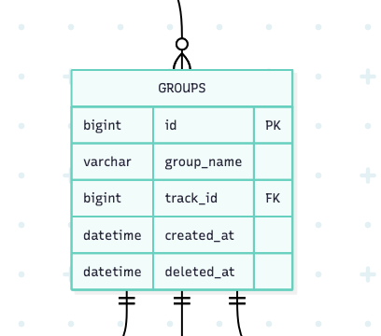
Legacy `matching` tables store their own students, mentors, groups, interests, and availability
Add `match_run` and `match_recommendation` records with score, explanation, and acceptance status
Introduce new entity `mentor_availability`
POST /api/v1/matching/group-runs​
POST /api/v1/matching/mentor-assignments​
POST /api/v1/matching/group-reassignments​
POST /api/v1/matching/mentors/{id}/deactivate​
GET /api/v1/matching/inactive-mentors/preview​
POST /api/v1/matching/inactive-mentors/replace

